Slide 1
Clustering mini project
Mall Customers Segmentation

Slide 2
Problem Statement:- To create customer cluster
Dataset:-
The data contains 5 variables to predict the churn with 200 customers observations.
1.Customer Id
2.Gender
3.Age
4.Annual Incone
5.Spending Score

Slide 3
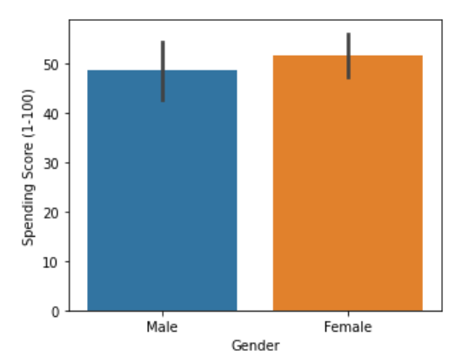
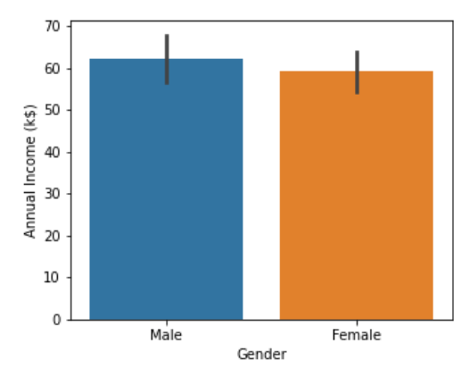
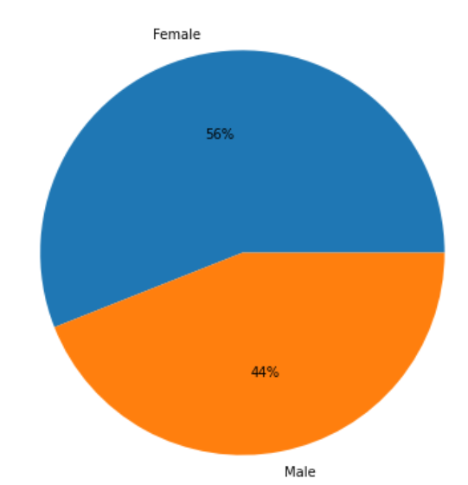
Data Exploring:-
Females are visiting the mall and spending more compare to males but the annual income of female is less.

Slide 4
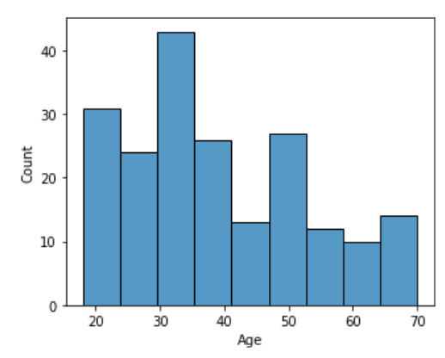
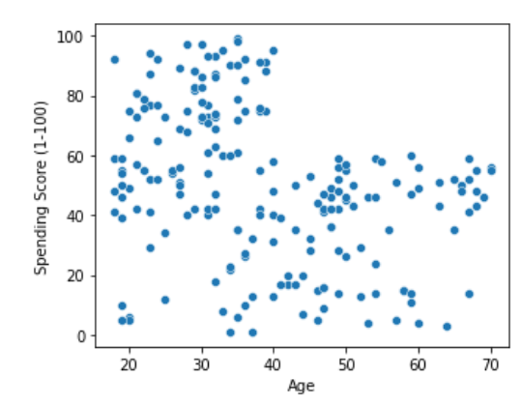
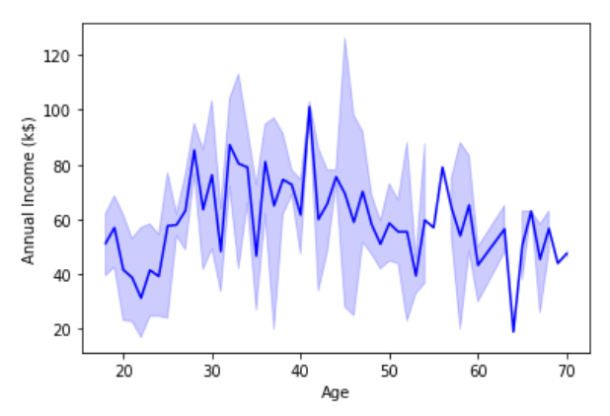
Age group of 20 to 35 visit the mall more frequent and the spending score is also high.

Slide 5
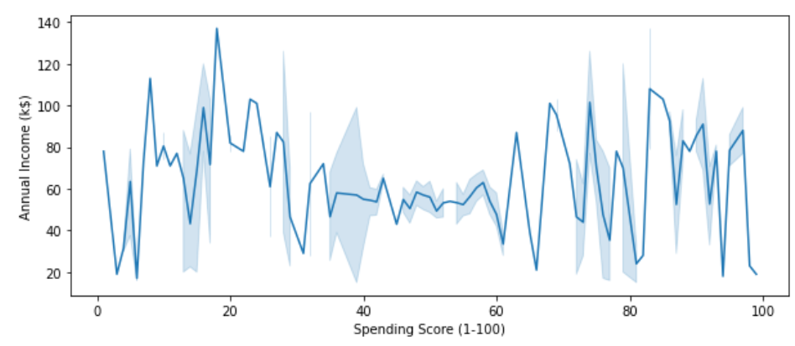
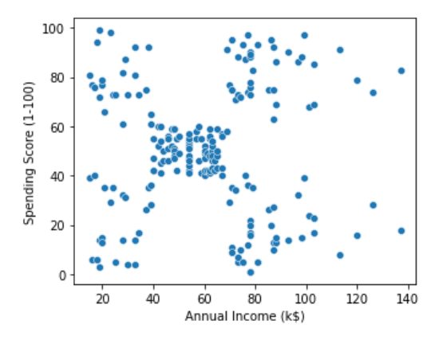
Annual Income v/s Spending Score
Customers with the high income has a low spending score.

Slide 6
Treatment:-
1.There are no nulls value.
2.Rename the column for Genre to Gender
3.Label encoding:-for Gender Column.
4.Scaling is not required.

Slide 7
Models Performance And Evaluation Using Silhouette Coefficient
Models | Age and spending score | Annual income and Spending Score
Kmeans | 0.499 | 0.539
Agglomerative | 0.403 | 0.048
DBSCAN | -0.283 | 0.23

Slide 8
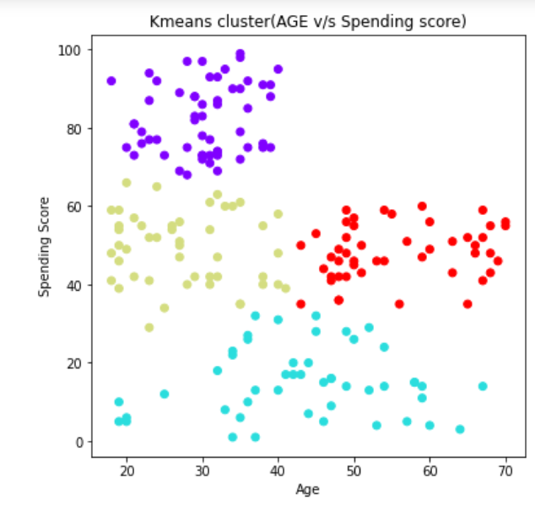
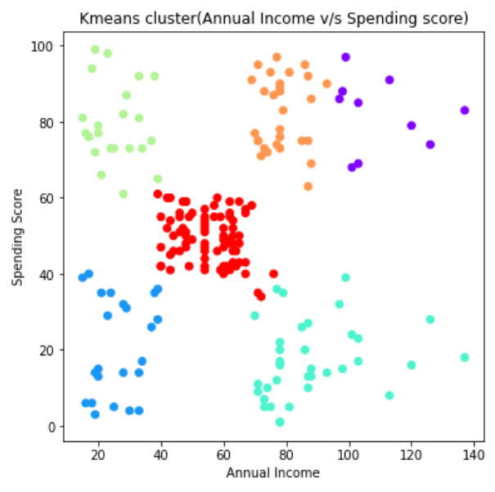
Kmeans Clustering

Slide 9
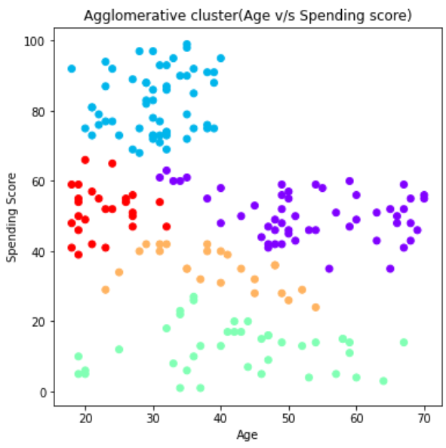
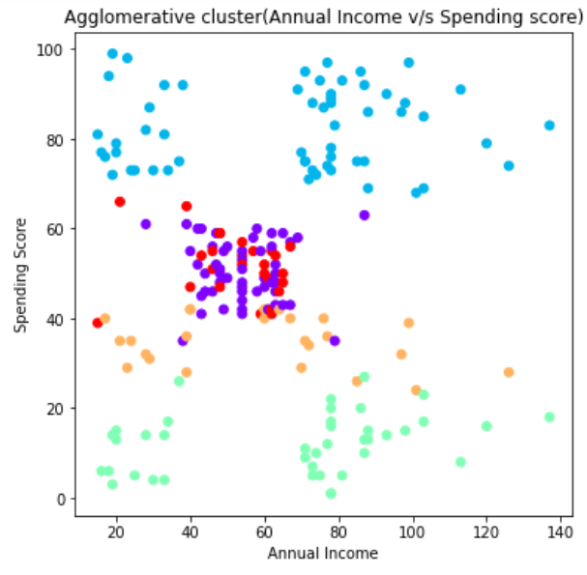
Agglomerative Clustering:-

Slide 10
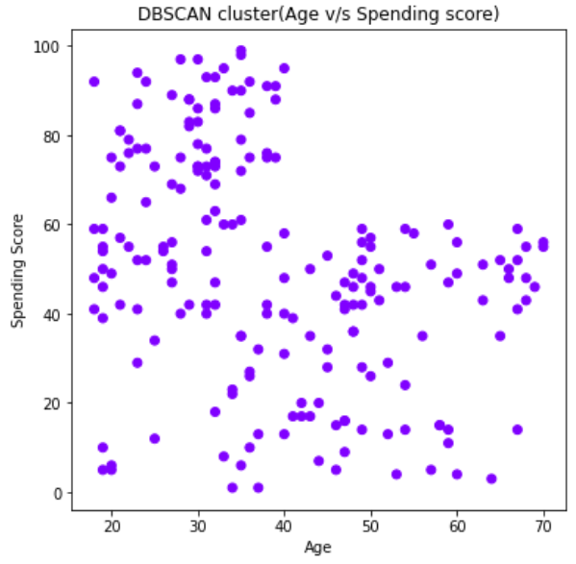
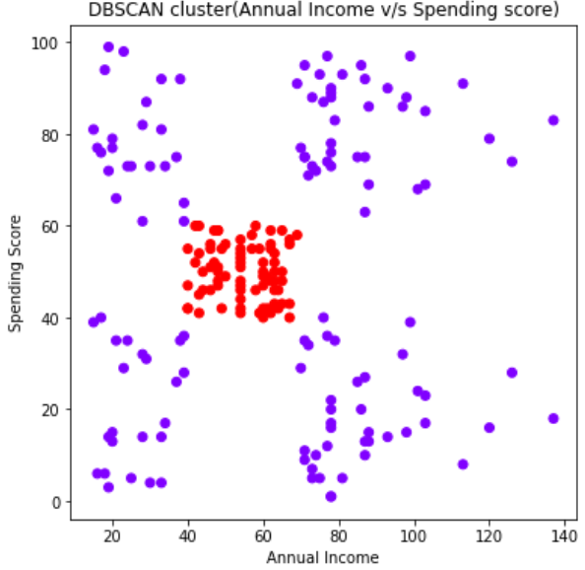
DBSCAN Clustering:-

Slide 11
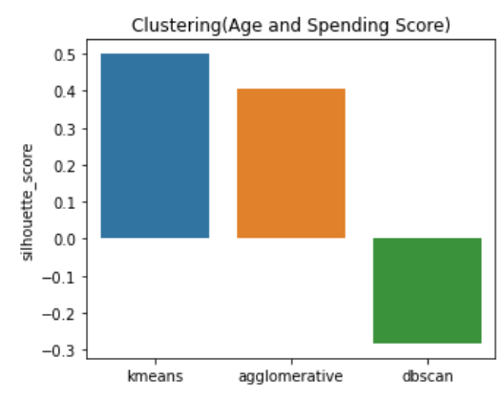
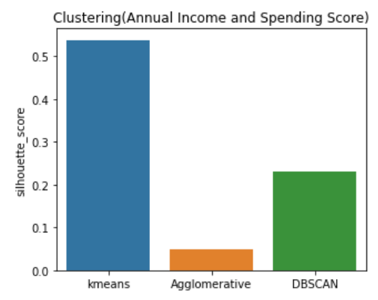
Best Model:-
Age and Spending Score
Annual Income and Spending score
The best model is Kmeans on the basis of silhouette score.

Slide 12
Conclusion:-
Target:-
1.Females
2.Age group of 20 to 35.
3.Customers with high income who spends less.

Slide 13
Thank you

